Slide 1
Ad-hoc Reporting
IZENDA 7
Blake Wright

Slide 2
What is Ad-hoc Reporting
Customized Reports:
Craft reports to suit your specific data requirements.
Precision reporting for data-driven decisions.
Highly Customizable:
Achieve nuanced data representation.
Flexibility for diverse reporting needs.
Specific Data Metrics:
Focus on granular data insights.
Precision in data analysis and presentation.

Slide 3
What is Ad-hoc Reporting
Visualization:
Transform raw data into informative visuals.
Enhance data comprehension and insights.
Breaking Data Barriers:
Overcome limitations of traditional reporting.
Empower data professionals with flexible data blending.
What is Ad-hoc Reporting? Data Empowerment!
Empowering data analysts and decision-makers.
Ad-hoc reporting: Elevating data analysis to precision and flexibility.

Slide 4
What’s new in IZENDA 7
All-in-One Awesomeness!
Create reports and multiple charts all on one page – no more data juggling!
Super User-Friendly!
Say goodbye to tech headaches with our sleek, easy-breezy interface.
Style It Your Way!
Customize your analytics with multiple grid styles – your data, your rules!

Slide 5
What’s new in IZENDA 7
Effortless Scheduling!
Set it and forget it – schedule reports with Izenda 7 for smooth sailing.
Zero Crashes, Hooray!
No more "Uh-oh!" moments – Izenda 7 keeps the party going with no crashes! YAYYYYYY!
What's Hot? Izenda 7!
Get ready for the ultimate data thrill – discover what's new and exciting! 🚀

Slide 6
Time for Real Stuff
Ladies and gentlemen, get ready to dive into the enchanting realm of IZENDA 7, where we'll be weaving reports so impressive that even the office plants will give us a standing ovation (well, if they could stand). 🌿📊
Let's put on our data wizard hats and conjure up some reports that'll make the conference room giggle with Graphs! 🧙‍♂️💼

Slide 7
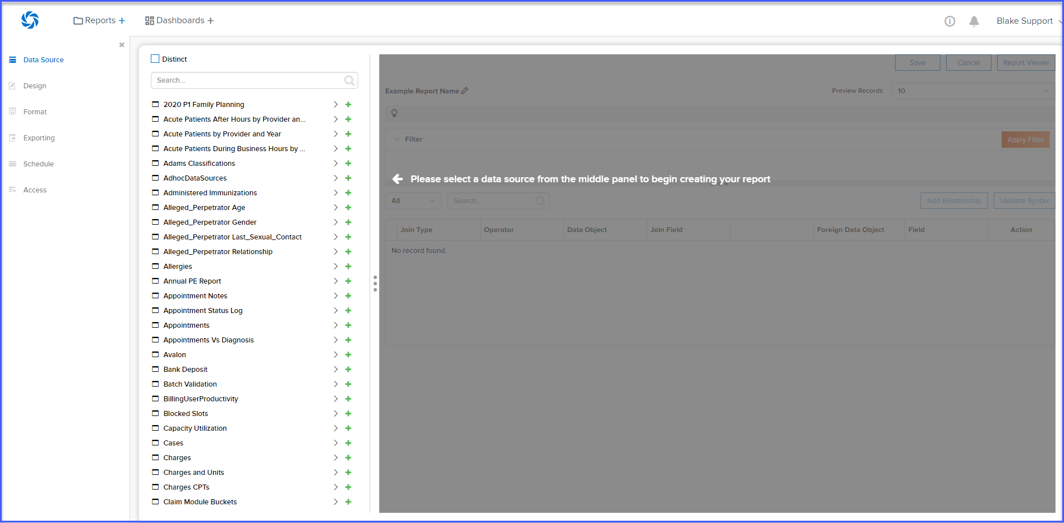
IZENDA 7 At A Glance

Slide 8
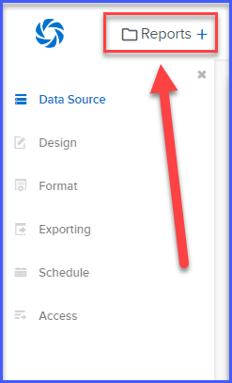
How To Create A Report

Slide 9
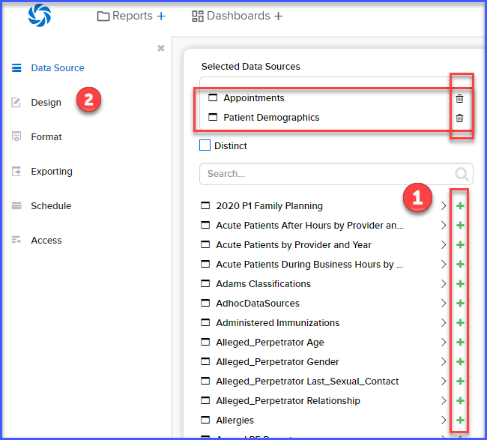
Selecting Data Sources

Slide 10
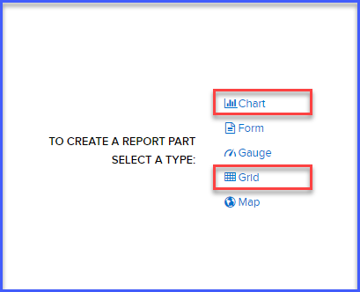
Selecting The Reporting Option

Slide 11
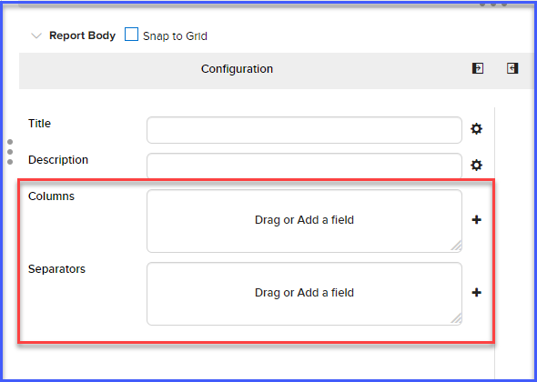
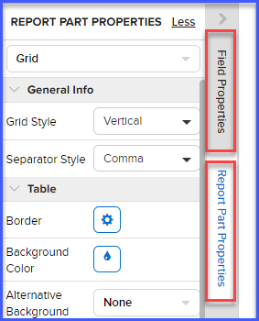
Report Designer

Slide 12
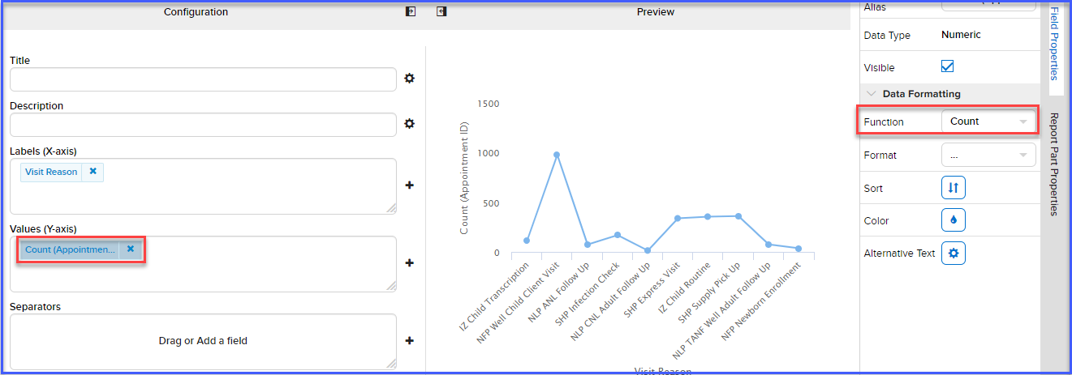
Creating Charts

Slide 13
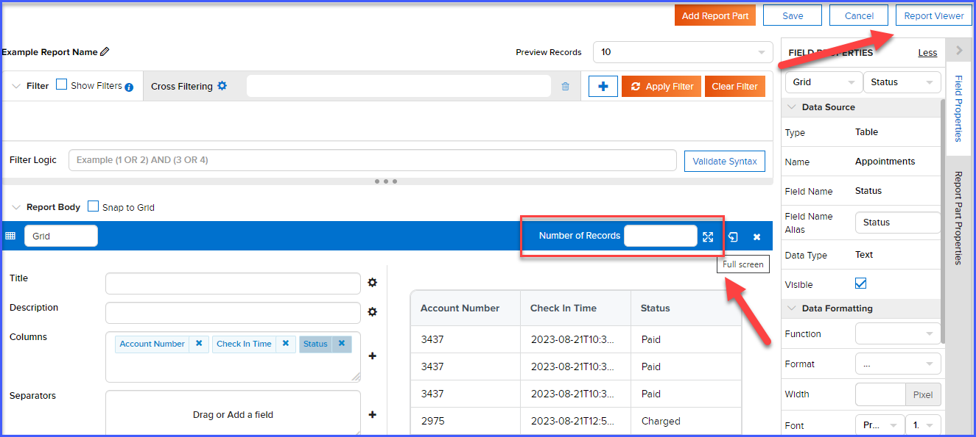
Report Viewer

Slide 14
Applying Filters

Slide 15
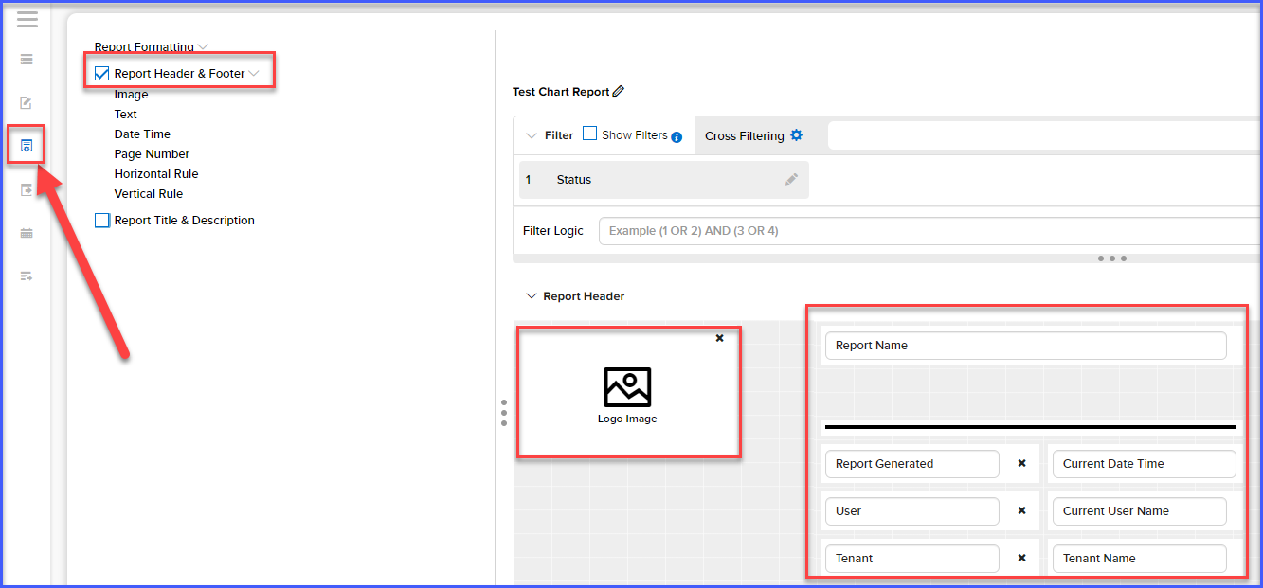
Report Formatting

Slide 16
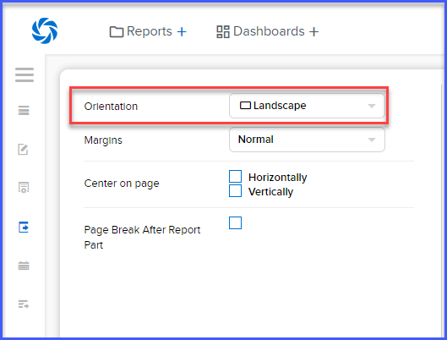
Report Orientation and Margins

Slide 17
Thank You
For Your Attention

